Slide 1
Health Update

Slide 2
Health update
Forget to check up at the doctor?
Want your doctor at close range?
Do you want to keep tabs on your health?
Health Update is the app for you!!

Slide 3
Main features:
Can monitor several different body several different body vitals
A small wearable device that that looks like any other clothing item,
And another button in case of emergencies
Can detect abrupt changes in a patient’s vitals and will automatically notify the user
Patients can get immediate guidance from healthcare professionals based on their health conditions

Slide 4
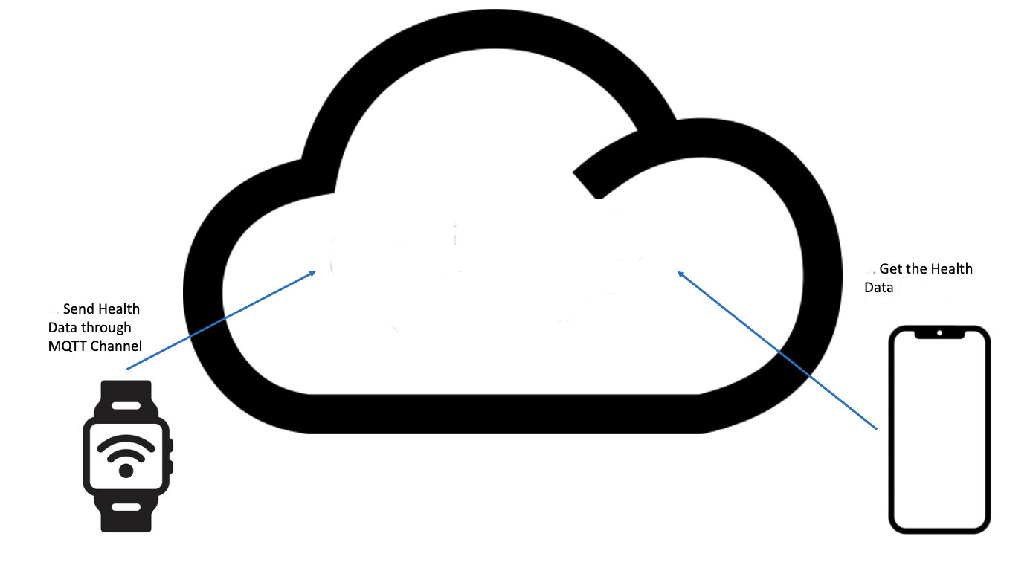

Design & architecture
Panic button immediately sends last health updates and contacts physician

Slide 5
The device
Small device that can be incorporated into smartwatches or other to clothing items
Always on person so it will be connected to the internet through mobile phone
A device that is resistant to different weather conditions
Can detect different body vitals
A panic button for emergencies
All data is kept in database

Slide 6
Design & development steps
Buy the material and assemble the devices
Test the device to check if it can read body vital correctly
Buy cloud service & MQTT broker
Development of a program that reads data from the device and then generates a push notification to the topic (Pub/Sub)
Develop an app that subscribe to the topic (Pub/Sub) and present the current data to the user
Save all data in local database with the option to send the data in case of emergencies
Test the entire product from end to end. From the device to app

Slide 7
Workflow
Device
MQTT broker & Cloud Service
App
Panic Button
DB

Slide 8
Summary
People will have a better indication about their health status, now that they can just open their smartphone and look instantly.
People could have regular health check without the need to physically go to the doctor.
Doctors can check the vitals of a patient regularly and keep up to date with patients.
We use the device to get the reading and send them via push notification to the app that is subscribed to the topic.
We will provide a better health treatments and follow up regarding our health, This in turn will provide a better living condition to all people.

Slide 9
Health update – Project CODE
https://github.com/Tzach182/IOT_SMART_HOME

Slide 10
Bibliography
https://how2electronics.com/iot-patient-health-monitoring-system-esp8266/
https://www.frontiersin.org/articles/10.3389/fpubh.2023.1188304/full

Slide 11
Video presentation
https://youtu.be/qR8scj1NemM

